Slide 1
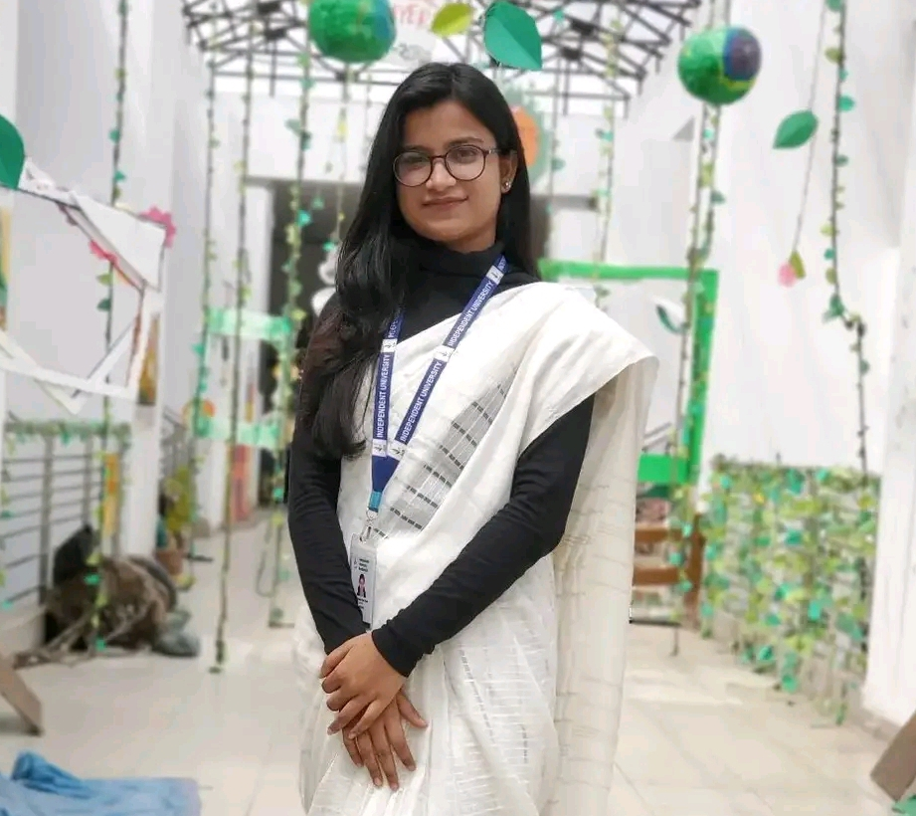



Most Rokeya Akter Basuri
01784644277
Rokeyabasuri0@gmail.com
Road 20, j block, Baridhara, Dhaka

Slide 2
About Me
As a dedicated and ambitious finance student, I bring a strong academic foundation in finance and a passion for active participation in various events and activities. My commitment to community engagement is evident through my volunteering experiences, which have allowed me to develop teamwork, communication, and problem-solving skills. I thrive in group settings, valuing collaboration and contributing to the collective success of teams. My multifaceted approach to personal and professional development makes me an asset to any organization or project.

Slide 3

education
Bachelor of Business Administration (Finance), 6th semester. Independent University Bangladesh (IUB).

Slide 4


work History
· SETS fest organized by the School of SETS, IUB
Student On Duty- worked as a SOD at IUB library for the summer’22 semester, maintained the rush, and communicated with the students.
· Kolpokoushol organized by Universal Machine Inc. and hosted by IUB.
· IUB SBE Alumni Fest’23
· The CBoBS event in IUB from the club Global Gatekeepers

Slide 5
skills
Mother tongue- Bangla
Interpersonal- Clear written and verbal communication, Strong leadership for a staff team of 10+
Organizational- Scheduling, calendar management and multitasking.
Language skills- English, French (Elementary).
Job-related skills- Business administration and documentation control.
Soft skills- Microsoft Word, Excel, PowerPoint, Python (Basic), 33wpm typing speed.

Slide 6



hobbies
Reading Books (Especially Tragedy, Mythology, Thriller)
Watching movies
Collecting books

Slide 7
Membership and Affiliations
An active member of the Independent HR Society
General Member of Independents Marketer’s Association.
General Member of the Global Gatekeepers. General members of IUB Debate Club.

